Slide 1

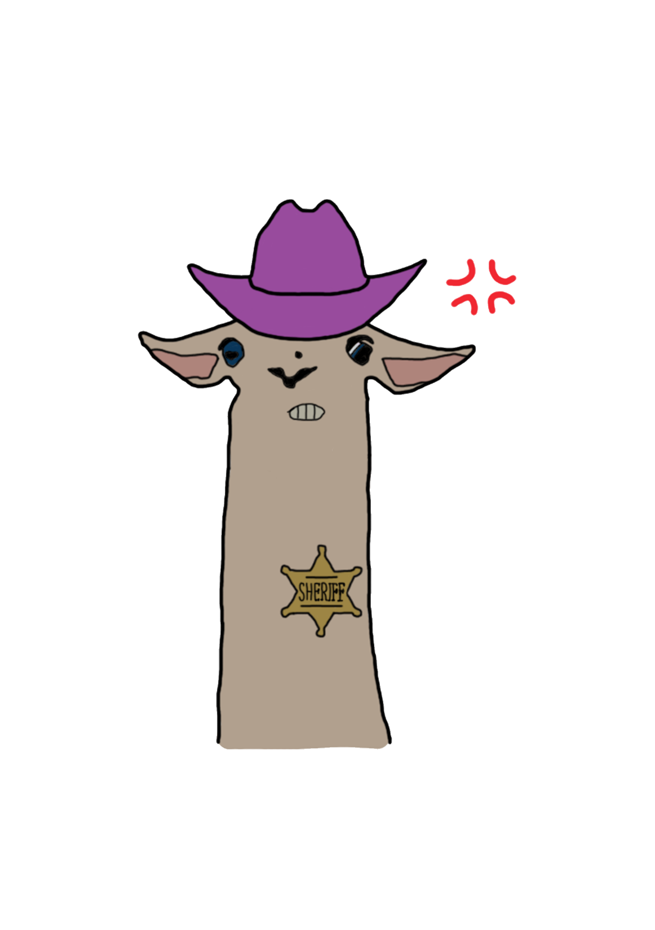

Group 6
Pitch Gold
Notes:
Everyone

Slide 2
The Brief
2D
Tap input
Turn-based single-device multiplayer
Symmetric level design
Easy to learn game yet hard to master
Notes:
Tom
Input is single instant of contact.
Local multiplayer – adversarial. Asynchronous player turns.
Symmetric – players have access to the same knowledge and equal opportunity regarding input effect.

Slide 3
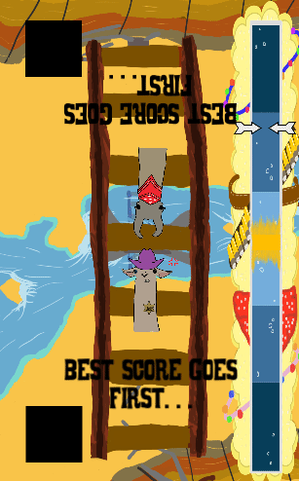
What is our Game?
Timed tap
Asynchronous, turn based
Win/lose condition
Notes:
Tom

Slide 4
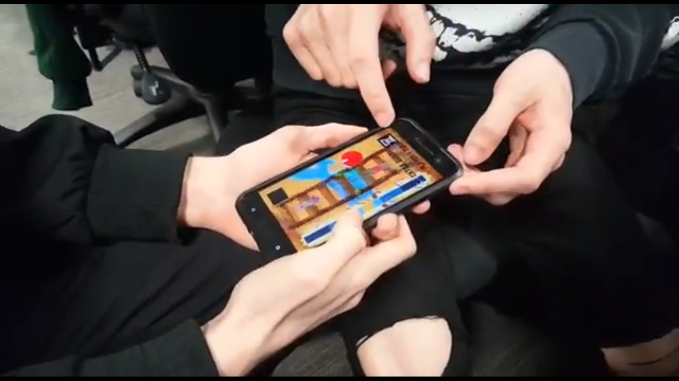
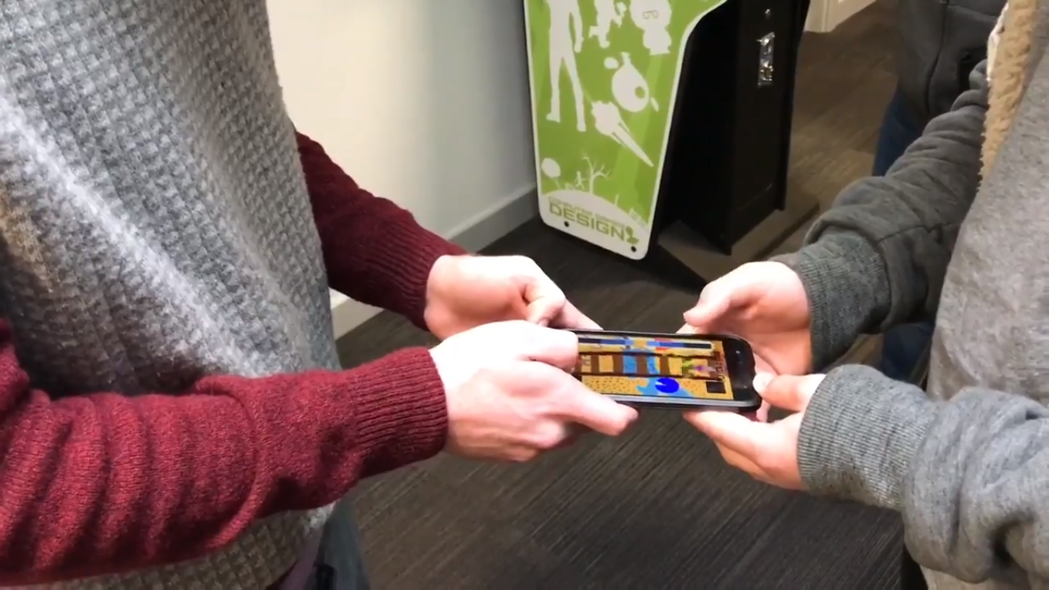
What does the player do?
Notes:
Tom

Slide 5
Game loop
Time
Progress
Tap
Notes:
Tom

Slide 6
Final Build
Most accurate tap wins first turn
Notes:
Tom

Slide 7
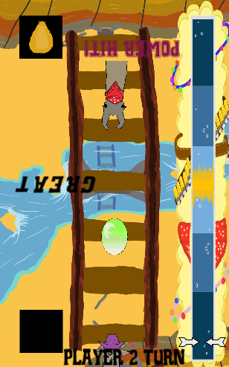
Final Build
Win condition
Notes:
Tom

Slide 8
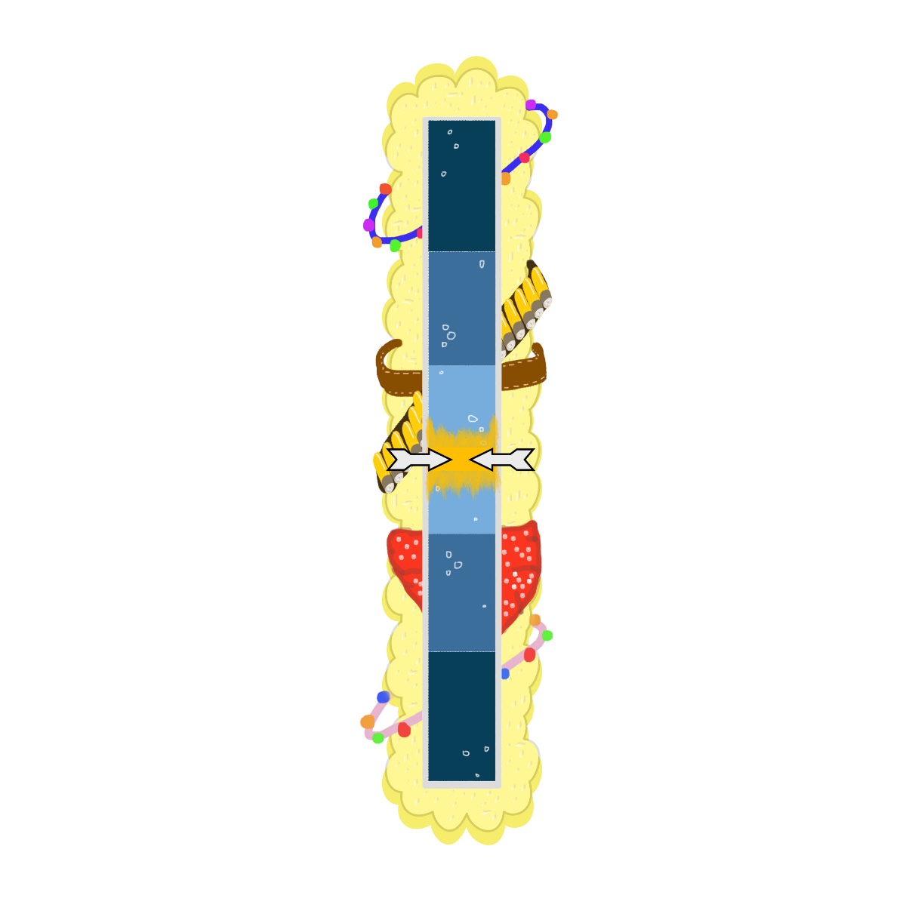

Power Meter
Feedback
Zones
Speed
Notes:
Dan

Slide 9

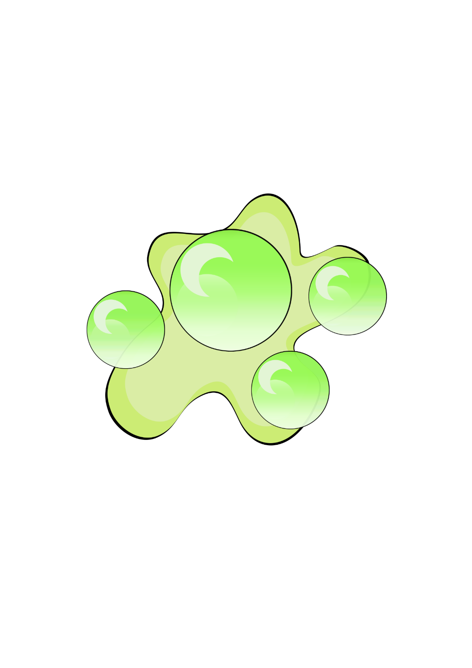

Character Design
Initial weak theme
Theme encompasses all elements
Affordance
Notes:
Jack

Slide 10
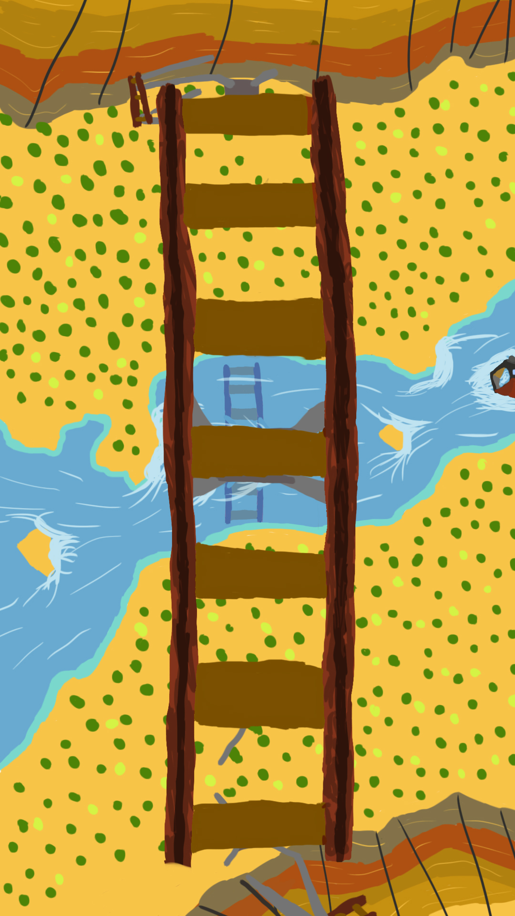

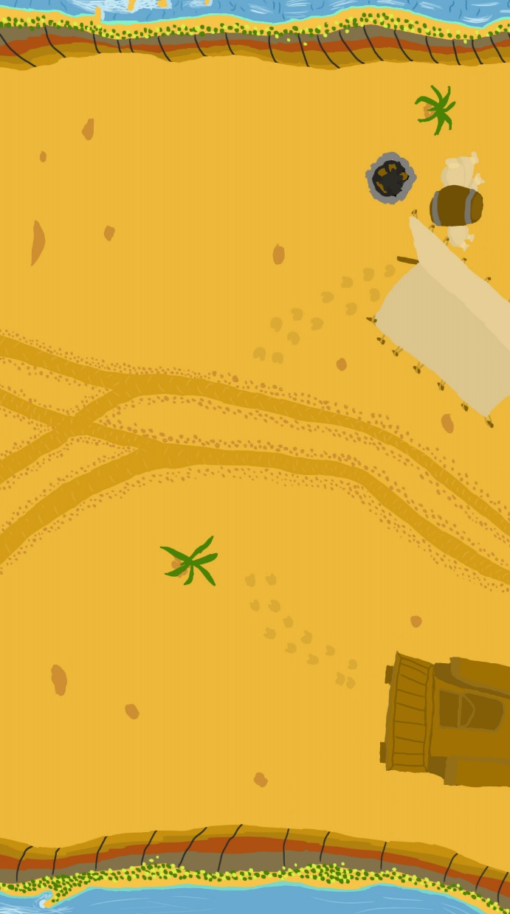
Background Design
Iteration: less ‘busy’ background
Visible hazards in game scene
Notes:
Jack

Slide 11

Emotive feedback
https://youtu.be/QnHehQsqNtM

Slide 12
Emotive Feedback
Schadenfreude
Diluted by confusing telegraphing

Slide 13
Design Lessons
Initial design phase
Thinking of emotion before mechanics

Slide 14
Programming Lessons
Intuitive variable names
Making appropriate variables accessible in editor
Clear code layout with comments

Slide 15

Management Lessons
Communication
Scope

Slide 16

Notes:
all

